Slide 1
Partnership
A Tata approach
6th March 2014

Slide 2
Tata group partnerships
Partnership with PE
Joint ventures

Slide 3
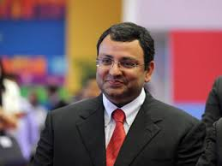
Long-term stakeholder value creation
“Ultimately our very purpose is long-term stakeholder value creation”
(Cyrus P Mistry’s 1st New Year message to all Tata employees, January 2nd, 2013)

Slide 4
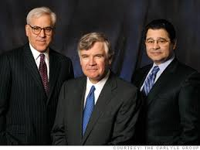
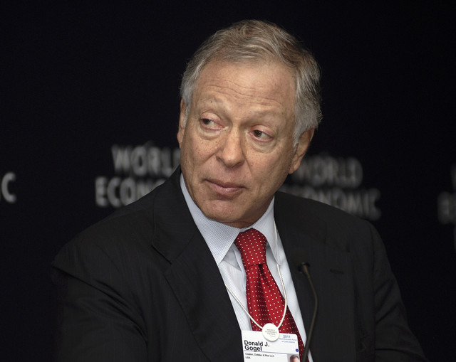
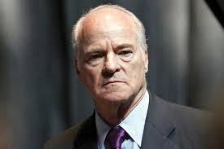
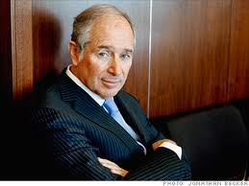
PE brands built over 25 years

Slide 5
Value of the Brand
Valued the Tata Brand as the best Indian Brand at $ 21.1 Bn
Valued the Tata Brand as the best Indian Brand at $ 10.9 Bn

Slide 6
Key learnings

Slide 7
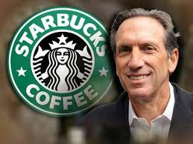
Identify partners based on shared vision
“We are very pleased to have found the best partner for Starbucks in Tata- a company that shares so many of the same values for conducting business in a way that earns the trust and respect of our customers and partners (employees).”
Howard Schultz, Chairman & CEO, Starbucks Corporation

Slide 8
Develop a shared business perspective
10 year plan
5 year plan
100 day plan

Slide 9
Manage the company through the Board
Management should be responsive to the board, and not to the individual partners

Slide 10
Take the best from each partner

Slide 11
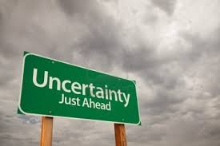
Limit uncertainty

Slide 12
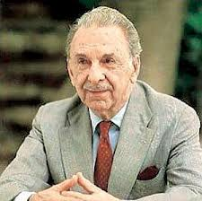
Demonstrate humaneness
“To be a leader, you have got to lead human beings with affection.”
JRD Tata, Chairman, Tata group, 1938-1991

Slide 13
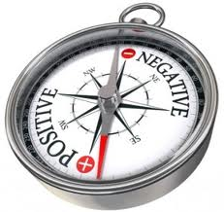
Manage perceptions

Slide 14
Key learnings - Summary
Develop a shared business perspective
Demonstrate humaneness
Manage perceptions
Limit uncertainty
Take the best from each partner
Manage the company through the Board
Identify partners based on shared vision

Slide 15
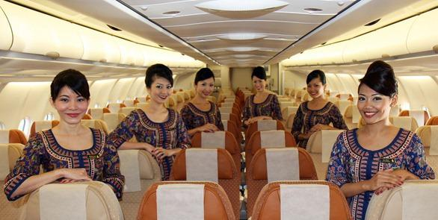
TATA – SIA

Slide 16
Thank you !

